Slide 1
Cloud Based chatbot
Ghuge rushikesh
Ghule Atharva
Karande sarvesh

Slide 2
Indroduction
A chatbot is a program that communicates with you.
It is a layer on top of, or a gateway to, a service. Sometimes it is powered by machine learning (the chatbot gets smarter the more you interact with it). Or, more commonly, it is driven using intelligent rules (i.e. if the person says this, respond with that).

Slide 3
Essentially chatbots are of two types:
Command based: Chatbots that function on predefined rules and can answer to only limited queries or questions. Users need to select an option to determine their next step.
Intelligent/AI Chatbots: Chatbots that leverage Machine Learning and Natural Language Understanding to understand the user’s language and are intelligent enough to learn from conversations with their users.

Slide 4
Features
1) Achieving Conversational Maturity with Natural Language Understanding (NLU)
Previously, chatbots would only be able to respond to your queries based on a set algorithm. Now, however, chatbots have evolved and with NLU capabilities, a chatbot is capable of understanding the very context of a conversation. If available, even in any language.

Slide 5
2) Chatbot Integration with CRM platforms
As chatbots are becoming more intelligent, they are now also capable of orchestrating workflows.
3) The Capability to Become Emotionally Intelligent
A chatbot must be emotionally intelligent. It has now become an integral part of any AI-powered chatbot of the present era. They should possess the element of studying customer’s personality traits and understanding their tone and sentiment. Based on their emotional levels, a chatbot must be fully adept at setting the tone while interacting with the customer.

Slide 6
Methodology
Successful chatbots are designed to learn, making maintenance an integral part of the chatbot development methodology. Once the chatbot is interacting with real users it is important to analyze user feedback and sentiment, along with other insights the interactions may produce.

Slide 7
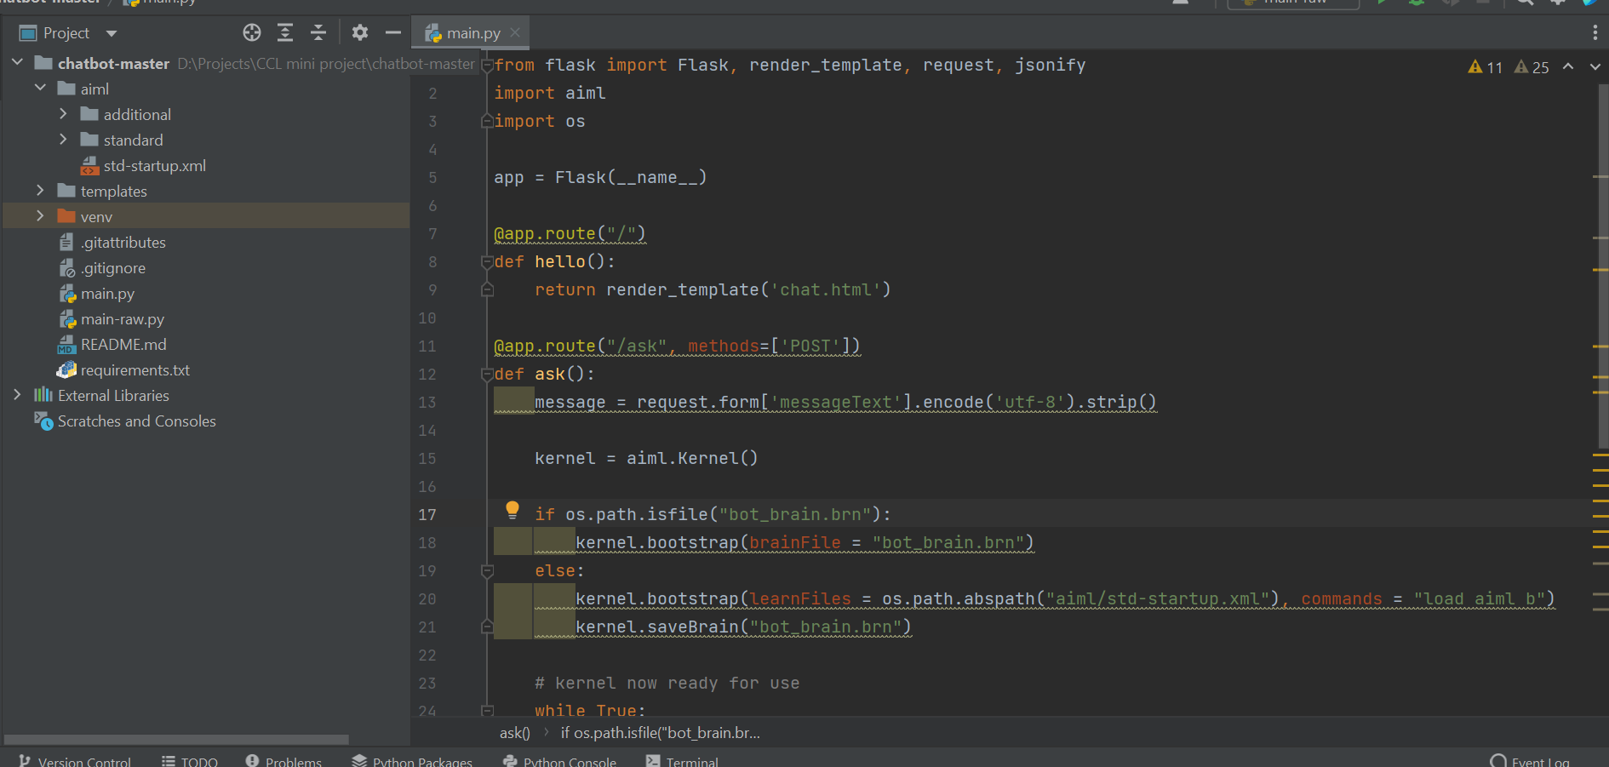

Slide 8
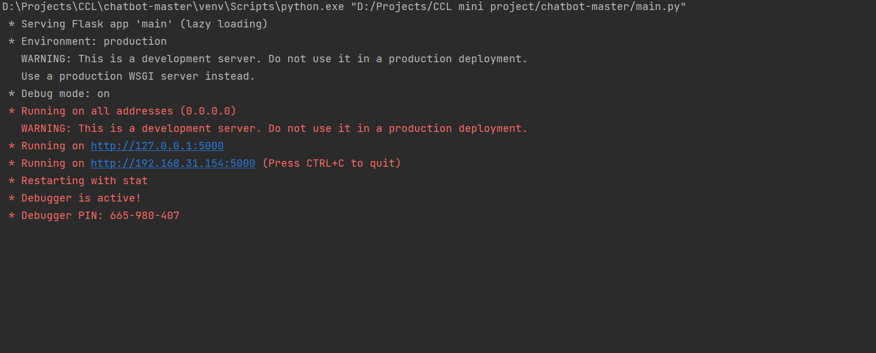

Slide 9
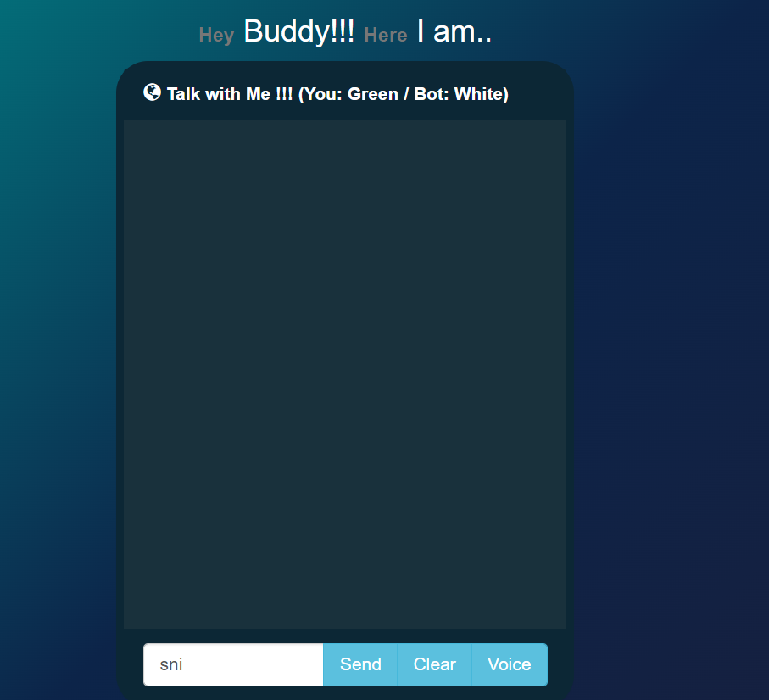

Slide 10
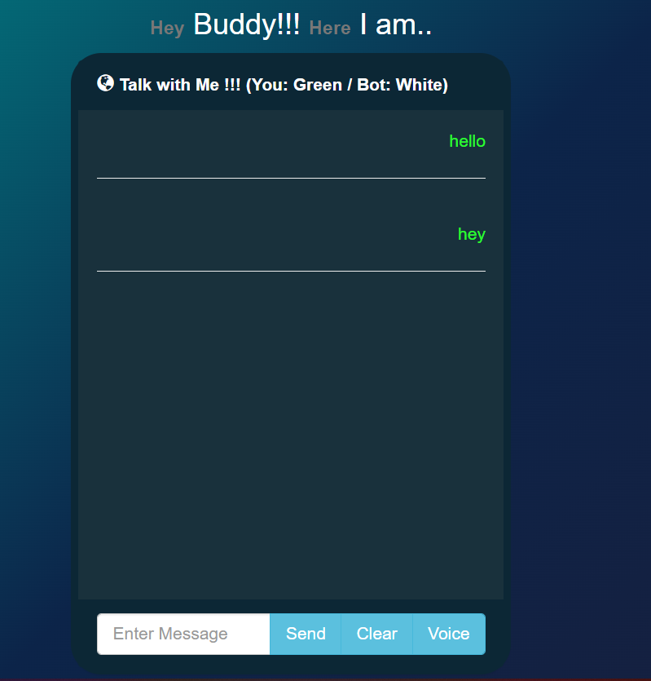

Slide 11
Applications
24/7 support: Chatbots are perfect to scale your support capabilities without having to scale your team. They can be available around the clock to offer instant and accurate responses as they don’t tire or feel the need to take breaks. Chatbots can also be built to assist customers in their preferred languages, and can be deployed across channels to improve accessibility.
– Automated resolutions: In addition to suggesting solutions from your knowledge base, chatbots can also automate resolutions to frequently reported issues. Using Freddy Self-service, you can build robust workflows by integrating with an array of third-party applications, and offer resolutions within seconds.
– Lower operational costs: Deploying an AI-powered chatbot to tackle the increasing number of customer queries is a cost-effective way to scale your customer service efforts. These chatbots can handle multiple customer conversations at once, and significantly reduce the costs that are associated with scale.
– Better customer experience: AI-powered chatbots can be designed to understand the intent of the customer and automatically trigger the right conversational flow to offer a proactive and complete customer service experience.

Slide 12
Conclusion
However, there is one solution primed to satisfy the modern customer, and that is a chatbot. With a chatbot, your organization can easily offer high-quality support and conflict resolution any time of day, and for a large quantity of customers simultaneously.

Slide 13
References
Google
Github

